Slide 1

BREAKING THE DATA ENCRYPTION STANDARD
Presented By: Team 2
Shweta Parihar
Pooja Agrawal
Ahmad Alhonainy

Slide 2
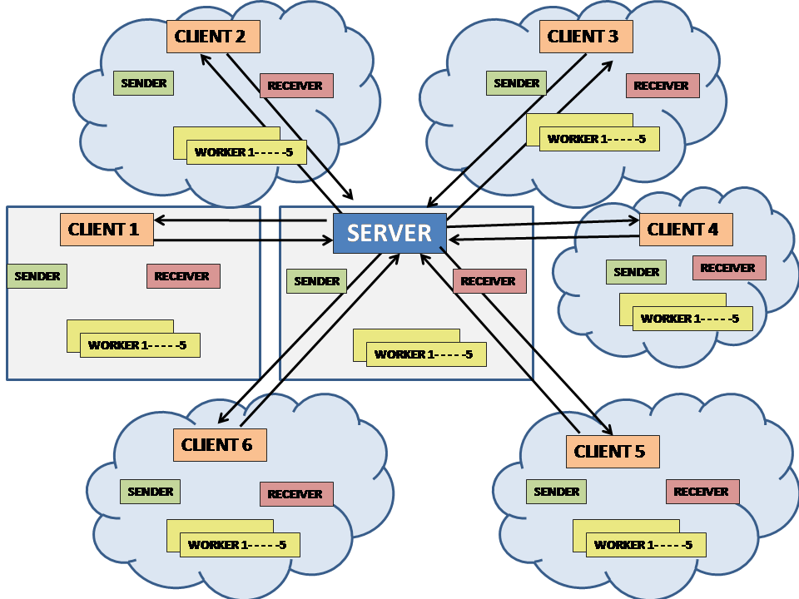
ARCHITECTURE

Slide 3
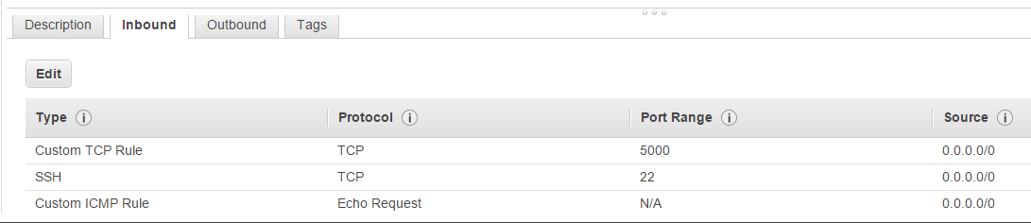
PRE-REQUIRMENTS FOR THE APPLICATION
1. All systems(physical and EC2) should have binary file of des.
Cmd: sftp –i <pem file absolute path> <user name>@ <IP Address>
put <file_name>
Eg: sftp –I AboFaris.pem ubuntu@52.25.7.51
put des
2. Router must have setting that whenever any message comes to port 5000 then it should forward it to Master’s wifi LAN Address.
3. Also we had to add some new network rules to the security group assigned to our instances. An inbound and outbound rule in order to open port which was 5000 in our case.

Slide 4
PROJECT FLOW
Master initiates the program.
Cmd: ./des <isMaster> <computerId> <maxNoOfComputers> <masterIpAdd> <client1IpAdd> <client2IpAdd> <client3IpAdd> <client4IpAdd> <client5IpAdd> <client6IpAdd>
Client gets initiated and waits in a while loop to receive two commands from master I.e. Master’s IP Address and START command.
On receiving these commands clients comes out of while loop and calculation starts.
On basis of totalNoOfIteration and maxNoOfComputers number of workers are calculated for each machine. By default every machine has 5 workers but the last machine could have more than 5 workers depending on the reminder.
On the basis of computerId, start and end for each worker is calculated.
After these calculations workers starts searching the key.
Now here comes two cases:
If Master founds the key
If Client founds the key

Slide 5
CASE 1: Master finds the key
When any worker belongs to Master finds the key, then the Master sends three things to every client.
Text message “ MASTER: I FOUND THE KEY”
Key
STOP Message
And then program exits
CASE 2: Client finds the key
When any worker belongs to Client finds the key, then it sends text message to Master “ CLIENT: I FOUND THE KEY” and then Master sends four messages to all clients.
Text message “ CLIENT: I FOUND THE KEY”
Key
Worker_Id of the worker that found the key
4. STOP Message
And then program exits.

Slide 6

PROBLEMS FACED
Brute Force Logic implementation problem
Key division Problem
Left-Over Reminder Problem
Setting up Router Rule

Slide 7

WHAT WE LEARNT ?
Different ways to secure our data.
Importance of information security.
Different security models.
Different Access control models.
Difference between IPv4 and IPv6.
Socket Programming in C
Multi Threading in C
How to use cloud infrastructure in real time
How secure is secure?
From this project we have learnt that breaking DES is not an easy task.

Slide 8

QUANTAM COMPUTING
What is Quantum Computing?
Quantum computing is a major development in the computer world use quantum-mechanical phenomena, such as superposition and entanglement, to perform operations on data.
How it works?
As we know digital computers used binary digits (bits), which is (0 or 1), however quantum computing uses quantum bits (qubits), which can be (0 or 1) in superposition of states.
For example: A classical computer each bit represents either a one or a zero, for 2 bits it will take 2^2 states which are (0,0)(0,1)(1,0)(1,1).A quantum computer maintains a sequence of qubits. A single qubit can represent a one, a zero, or any quantum superposition of those two qubit states, so a pair of qubits can be in any quantum superposition of 4 states.
The benefits of this development in computing.
This development will make the computer capabilities much better than they are now. For example, to analyze the number consists of 230 set this process will take long time by the latest classical computers. Quantum computers may represent a solution to such problems.

Slide 9
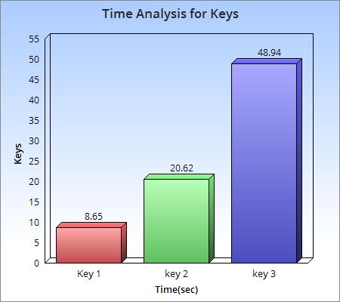

RESULTS FOUND
Plain text: 100001011110100000010010101010000001111000010101011010000000101
64 Bit Key: 0000000000000000000000000000000000000000000010000000000000000000
Cipher text: 0001111011111111100001110101100010101110110001110000011111111001
Plain text: 100001011110100000010010101010000001111000010101011010000000101
64 Bit Key: 0000000000000000000000000000000000000000000100000000000000000000
Cipher text: 1011111011111110110010001110101100011001000111010010110111001001
Plain text: 100001011110100000010010101010000001111000010101011010000000101
64 Bit Key: 0000000000000000000000000000000000000000001000000000000000000000
Cipher text: 1101101000110111110011111001111110010000110000000110110111010101
Current Key search: Still running……

Slide 10


